Slide 1

BROKER ACCREDITATION TRAINING Q4
PROUCT 2025 - CHANGES OVERVIEW
This highlight overview is in summary of the benefits and does not supersede the registered benefits & rules of the Scheme.
Contribution and benefits are subject to approval by Council of Medical Schemes. Please view full benefit details and guide at www.sizwehosmed.co.za

Slide 2
CREDENTIALS
& HIGHLIGHTS

Slide 3




SIZWE HOSMED MEDICAL SCHEME
2024 Member Distribution by Plan
BEST PERFORMERS 2024
Access Core
Access Saver
Gold Ascend/ EDO
FASTEST GROWING 2024
Access Saver
Gold Ascend/ EDO

Slide 4



DISTINGUISHING FEATURES
SIMPLICITY OF PLAN STRUCTURES
Competitive, affordable child rate, charged up to 26 years of age.
Members only pay for up to 3 child dependants (Fourth and more – free!)
Comprehensive Wellness, Maternity & Chronic care benefits paid from Scheme risk on all plans
Access Saver Plan – Optometry & Dental paid from Scheme risk
Value Platinum and Titanium advanced dentistry benefits paid from Scheme risk
Value Platinum and Titanium plans - built in Peace of mind – Should your MSA be fully utilised, a small self-funded payment gap applies – and then the Scheme will provide an additional amount of benefit to you – Your safety net!

Slide 5
OUR
PLANS

Slide 6

OPEN WINDOW PERIOD
A special open window period underwriting concession is opened for all existing or new employer groups joining the scheme for effective start date 01 January 2025 – Extended to 01 April 2025
Take advantage of our extremely competitive, well price child contribution rate
This concession allows any new member group employee, joining
the Scheme during this period, to be exempt from waiting periods and/or Late Joiner Penalties (LJPs).
One of the
lowest child dependant rates
in the industry AND
Scheme members pay for a maximum of three (3) child dependants, fourth or more are FREE
AND
Our unique definition of child dependant allows you to
pay this low child rate up to the age of turning 26 years
Key Terms of Reference:
The concession applies only where there is an employer-employee relationship between an existing group and the member.
No underwriting waiting periods will apply.
This concession excludes parents of member applicant
Access your benefits from 01 Jan 2025.
Because at Sizwe Hosmed we’re more than just a medical scheme – we’re your partner in health.

Slide 7
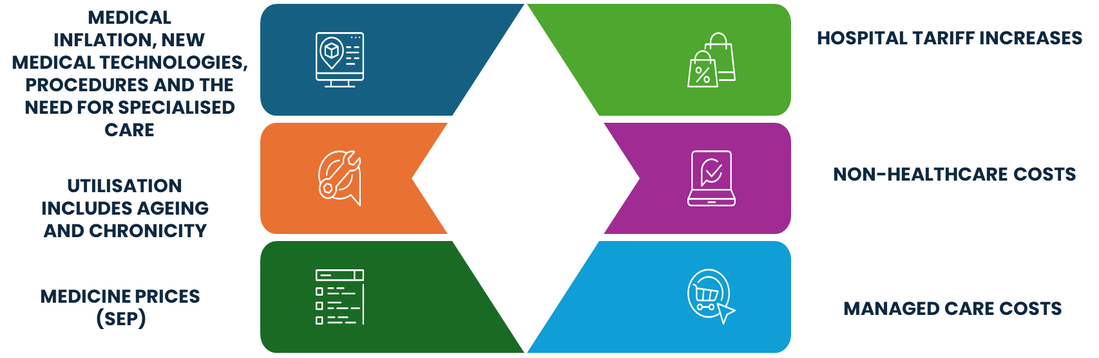

BENEFIT DESIGN 2025 – GUIDING PRINCIPLES
Working hard to enhance our products and services.
Ensuring that you receive not just care, but the best care.
Simplifying the decision-making process, making it easier for you to understand and choose the benefit option that best fits your needs

Slide 8
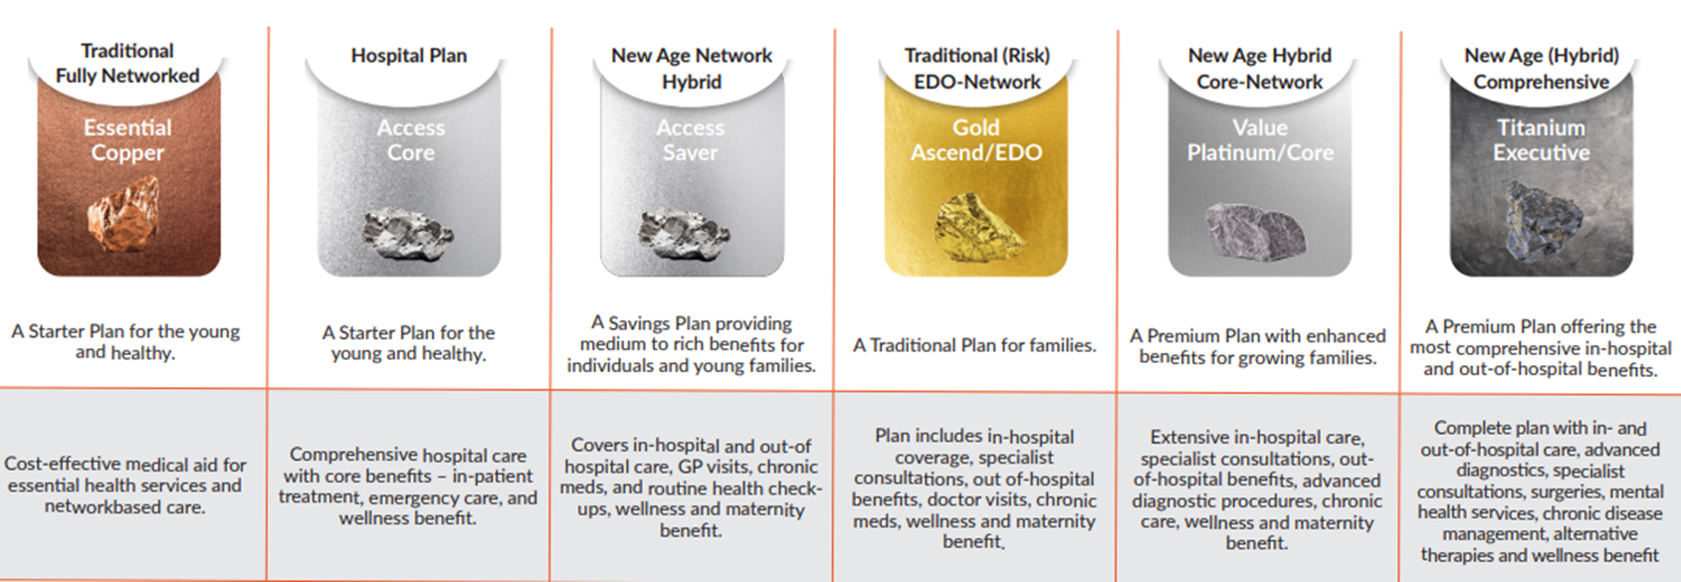
PLANS 2025
By consolidating our plans into a more focused range, we’re simplifying the decision-making process, making it easier for you to understand and choose the benefit option that best fits your needs,
whilst allowing us to allocate resources more effectively to better serve you.
Subject to approval by Council of Medical Schemes. This highlight overview is in summary of the benefits & contributions and does not supersede the registered benefits & rules of the Scheme.

Slide 9


BENEFIT CHANGES AND ENHANCEMENTS 2025
As we navigate the complexities of modern healthcare, we want you to know that
we are dedicated to delivering exceptional benefits and services that cater to your needs.
MSA
BENEFIT ENHANCEMENTS
ESSENTIAL COPPER
PRODUCT RATIONALISATION
MSA RULES
Overall 5% benefit enhancement on all options
Optical Benefits increase by 8%
Collapsing of the three income bands.
Addresses excessive cross subsidisation within this option
Further rationalisation of our benefit options to align with market norms and eliminate inefficiencies.
Titanium and Value Platinum: Optical and Conservative Dentistry payable from MSA.

Slide 10











THE PRODUCT SUITE
Streamlining our 8 options to 6 ensuring that our benefits are more tailored and impactful, providing you with more relevant and accessible benefit options for 2025.
Titanium Executive
1
+
=
Value Platinum
Value
Platinum Enhanced
Value
Platinum / Core
2
Gold Ascend/ EDO
3
+
Platinum Enhanced EDO
=
Value Platinum CORE
Value Core
Access Saver
4
+
=
Titanium Executive
Access Core
5
Plus
Titanium Executive
Essential Copper
6
After a thorough analysis, Sizwe Hosmed has decided to streamline its benefit options by merging or joining some of its existing plans that were similar in structure.
The streamlining of benefits means members have focused and impactful health benefits to choose from. In addition, the Scheme can use its resources better to serve members.

Slide 11




ADVANTAGES OF VALUE PLATINUM
& TITANIUM RANGE OF PLANS
We’re working hard to enhance our products and services, ensuring that you receive not just care, but the best care.
Unused MSA funds accumulate year on year and, are refundable should member leave a savings type plan.
Its Your Medical Savings Account!
Value Platinum range has a 22.5% Member Savings Account (MSA) & Titanium Executive has a 20.8% Member Savings Account, for
Out-of-Hospital Benefits
Member Saving Accounts (MSA) allows member more freedom to use the savings where they most need benefit.
New Age Hybrid Core-Network
New Age (Hybrid) Comprehensive
Built-in Peace of Mind
– Should your MSA be fully utilised, a Small Self-funded Payment GAP applies – and then the Scheme will provide an additional amount of benefit to you –
Your safety net!
Value Platinum/Core
Titanium Executive
In-Hospital, potential high-cost events, are covered by the Scheme along with:
PMB Chronic Conditions
Annual Wellness and Screening
Maternity Benefits

Slide 12
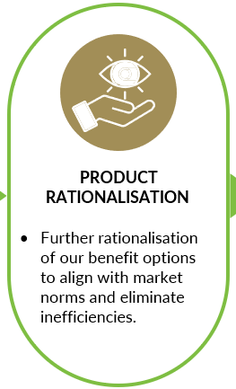

INCORPORATING PLANS – Effective 01 January 2025
Value plan members will be transitioned into the Value Platinum Plan or the Gold Ascend plan based on utilisation needs
Plus option members will be transitioned to Titanium Executive Plan
The new options offers a range of benefits that align more closely with the benefits that member has frequently used over the past year.
This will help reduce your out-of-pocket expenses, ensuring maximum value of your membership
Questions and Answers
Q- How will the move to the new Benefit Option take place?
A – Members have until 11 December 2024 to select a new benefit option by submitting an option change form.
Q - What happens if I do not fill out the Benefit Option change form?
A – The Scheme will automatically move the member into the new option after 11 December 2024.
Q- Does the move alter my membership record with the Scheme?
A – No. The move does not alter my membership record with the Scheme

Slide 13
BENEFIT ENHANCEMENTS
& CHANGES 2025
Subject to approval by Council of Medical Schemes. This highlight overview is in summary of the benefits & contributions and does not supersede the registered benefits & rules of the Scheme.

Slide 14




Register on the programme. Get your blood glucose tested. Receive expert advise from
CLICKS DIABETES NURSE EDUCATORS
NEW
No-Prick-’n-Bleed
product to test your blood glucose levels
Register and receive the DNE Service
Call 011 353 0454
Email: chronic@sizwehosmed.co.za
LIVING HEALTHY WITH DIABETES PROGRAMME
We’re working hard to enhance our products and services, ensuring that you receive not just care, but the best care.
This will be covered in line with PMB benefits
May be used in lieu of going to the GP for a diabetes check up
The Clicks Diabetes Educators will provide education on aspects of disease management such as , appropriate nutrition, how to manage your health, podiatry check by the nurse, checking glucose readings

Slide 15

HOSPITAL NETWORK PROVIDERS
Our mission is to provide comprehensive healthcare benefits to our members and their families when they need it most. We’re proud to inform you of our new partnership with Mediclinic and Netcare as our network hospital groups. These partnerships will enhance the quality of care and ensure that our members receive the best possible treatment and support for their health needs.
Visit www.sizwehosmed.co.za to find your nearest network service provider

Slide 16









GENERAL BENEFIT CHANGES& ENHANCEMENT SUMMARY 2025
Specific benefit categories will experience clinical rule or protocol definition, and sub-limits implemented within their overall annual limits,.
Specific benefit categories will be subject to implementation of a co-payment or deductible
Internal and External Prosthesis Clinical limits and
Rand sub-limits introduced.
Advanced
/Specialised Radiology
co-payment introduced for non PMB scans
Acute Medication Benefit enhanced to include formulary for vitamins
Gold Ascend Range
Pharmacy Advice Therapy (OTC) Medication - Sub-limited introduced R2 442 per family per annum.
Maximum R181 per script
Gold Ascend Range Hospice & Private Nursing benefit limit introduced
Access Core Benefit limit introduced for male & female sterilisation
Access Saver
List of deductables introduced
Benefits overall enhanced by 5% & Optical benefit enhanced by 8%
Laparoscopic Procedures, Hospitalisation and associated costs
co-payment introduced
Back & Neck Surgery
Co-payment introduced
Subject to approval by Council of Medical Schemes. This highlight overview is in summary of the benefits & contributions and does not supersede the registered benefits & rules of the Scheme.

Slide 17
GENERAL BENEFIT CHANGES PER PLAN 2025
Benefits enhanced by 5%, Optical benefit enhanced by 8%
Essential Copper
ESSENTIAL COPPER | CHANGE 2025
Internal and External Prosthesis | Aphakic Lenses (Subject to protocol and PMBs). Limited to PMBs at R6 204.45 per lens
Contribution Table income bands | Collapsing of income bands
Access Core
ACCESS CORE | CHANGE 2025
Laparoscopic Hospitalisation and Associated Costs | Procedures done in-hospital will attract a 20% co-payment* with exception of diagnostic laparoscopy, Aspiration/excision ovarian cyst, Lap-appendicectomy and repair of recurrent or bilateral inguinal hernias
Back and Neck Surgery | A co-payment of R5,000 is applicable to all non-PMB back surgeries
Male Sterilisation/ Vasectomy | Limit Introduced: Limited to R19 262.25 per beneficiary per annum
Female Sterilisation/ Tubal Ligation | Limit Introduced: Limited to R19 262.25 per beneficiary per annum
Radio isotope studies | Limited to PMB
Interventional Radiology | Limited to PMB
Internal and External Prosthesis | Limited to PMB: Clinical and other defined sub- limits introduced
 | Hip and knee (partial and total) only one joint per beneficiary per annum. Limited to PMBs.
 | One spinal level per beneficiary per annum. Limited to PMB
 | Vascular stents: 2 stents per family per annum
 | Cardiac stents: Maximum 3 per family per annum Limited to:
 | Bare metal stents: R12 700 per stent Drug eluting stents: R15 400 per stent
Subject to approval by Council of Medical Schemes. This highlight overview is in summary of the benefits & contributions and does not supersede the registered benefits & rules of the Scheme.

Slide 18
GENERAL BENEFIT CHANGES PER PLAN 2025
Benefits enhanced by 5%, Optical benefit enhanced by 8%
Access Saver
ACCESS SAVER | CHANGE 2025
Deductible* Applied for Day Procedures at Day Hospitals, These procedures will not be covered if done in acute facilities (* “A specific percentage or rand amount of the total hospital account related to a specific procedure as stipulated in the benefits per option that the beneficiary is liable for”) | Skin disorders: R1 867
 | Arthroscopy: R3 734
 | Bunionectomy: R3 734
 | Removal of varicose veins: R1 867
 | Refractive eye surgery, Aphakic lens: R3 734
 | Infertility treatment: R6 224
 | Non-cancerous breast conditions: R1 867
Internal and External Prosthesis | Clinical and other defined sub-limits introduced per below outlined
Spine: Instrumentation and disc prostheses (including all components and fixation devices for back/spine). Subject to overall prosthesis limit and PMB protocols | Maximum one (1) level per beneficiary per annum for spine
Prosthesis for joint replacement (Hip, Knee, Shoulder, and Ankle). Subject to overall prosthesis limit and PMB protocols | One (1) prosthesis and only one joint per beneficiary per cycle
Cardiac Stents Cardiac (Pacemaker, internal defibrillators, grafts, valves, etc.). Subject to overall prosthesis limit and PMB protocols | One (1) per lesion- maximum of three (3) lesions. Bare metal stents: R12,700 per stent. Drug eluting stents: R15 400 per stent
Advanced /Specialised Radiology | Limited to R20 000 per family per annum and Limited to two (2) scans per beneficiary per annum at a limit of R3 500 per scan event in or out of hospital. 10% co-payment is applicable for all non-PMBs - MRI/CT scans
Acute Medicines | Inclusion of vitamins
Subject to approval by Council of Medical Schemes. This highlight overview is in summary of the benefits & contributions and does not supersede the registered benefits & rules of the Scheme.

Slide 19
GENERAL BENEFIT CHANGES PER PLAN 2025
Benefits enhanced by 5%, Optical benefit enhanced by 8%
Gold Ascend/ EDO
GOLD ASCEND & EDO | CHANGE 2025
Laparoscopic procedures: hospitalisation and associated costs | Laparoscopic procedures done in-hospital will attract a 20% co-payment with exception of diagnostic laparoscopy, Aspiration/excision ovarian cyst, Lap-appendicectomy and repair of recurrent or bilateral inguinal hernias.
Back and Neck Surgery | A co-payment of R5 000 is applicable to all non-PMB back surgeries
Advanced/Specialised Radiology | Combined limit: R24 976.35 per family per annum and a 10% co-payment applicable for non-PMB MRI and CT scan
Hospice & Private Nursing | Limit introduced R6 069 pf
Internal and External Prosthesis | Aphakic Lenses (Subject to protocol and PMBs). Subject to overall prosthesis limit, at R6 774 per beneficiary per lens
 | Cardiac Stents Limited to three (3) cardiac stents per family per annum unless PMB. Vascular stents limited to two (2) per family per annum unless PMB
Pharmacy Advice Therapy (OTC) Medication – Subject to Sub- limit for Acute Medication - Subject to Day-to-Day limit | Sub - Limited introduced R2 442 per family per annum. Maximum R181 per script. Vitamins per listing now available
Subject to approval by Council of Medical Schemes. This highlight overview is in summary of the benefits & contributions and does not supersede the registered benefits & rules of the Scheme.

Slide 20


GENERAL BENEFIT CHANGES PER PLAN 2025
Benefits enhanced by 5%, Optical benefit enhanced by 8%
Value
Platinum & Core
VALUE PLATINUM & CORE | CHANGE 2025
Laparoscopic Hospitalisation and Associated Costs | Procedures done in-hospital will attract a R5 000 co-payment* with exception of diagnostic laparoscopy, Aspiration/excision ovarian cyst, Lap-appendicectomy and repair of recurrent or bilateral inguinal hernias
Back and Neck Surgery | A co-payment of R5 000 is applicable to all non-PMB back surgeries
Medicine to take home after discharge, (TTO) | Non PMBs, subject to MSA* benefit limit
Advanced/Specialised Radiology | Combined In- and Out-of-Hospital Specialised Radiology limit of R37 963.80 per family per annum. R1 653.75 co-payment per scan event except for PMBs.
Internal and External Prosthesis | Aphakic Lenses (Subject to protocol and PMBs). Subject to overall prosthesis limit, at R8 439.90 per beneficiary per lens
Optical and conservative Dentistry | Subject to MSA
Titanium Executive
TITANIUM EXECUTIVE | CHANGE 2025
Laparoscopic Hospitalisation and Associated Costs | Procedures done in-hospital will attract a R3,500 co-payment* with exception of diagnostic laparoscopy, Aspiration/excision ovarian cyst, Lap-appendicectomy and repair of recurrent or bilateral inguinal hernias
Back and Neck Surgery | A co-payment of R5,000 is applicable to all non-PMB back surgeries
Advanced/Specialised Radiology | Overall combined in and out of hospital specialised radiology limit of R49,936.95 per family per annum R1,653.75 co-payment per scan event except for PMBs.
Optical and conservative Dentistry | Subject to MSA
Subject to approval by Council of Medical Schemes. This highlight overview is in summary of the benefits & contributions and does not supersede the registered benefits & rules of the Scheme.

Slide 21
BENEFITS - MSA, SPG AND ATB - 2025
ATB
Risk paid benefit once the self-payment gap has been fully paid by a member.
Value Platinum | M | A | C
MSA Benefit (12 Months) -Based on annual contributions | R15,072 | R14,160 | R4,128
Self Payment (Excludes Acute Medication) | R2,345 | R1,986 | R512
Above Threshold Benefit (Excludes Acute Medication ) | R6,197 | R3,645 | R1,585
Value Platinum Core | M | A | C
MSA Benefit (12 Months) -Based on annual contributions | R14,328 | R13,728 | R3,660
Self Payment (Excludes Acute Medication) | R2,345 | R1,986 | R512
Above Threshold Benefit (Excludes Acute Medication ) | R6,197 | R3,645 | R1,585
Titanium Executive | M | A | C
MSA Benefit (12 Months) -Based on annual contributions | R24,432 | R21,624 | R5,004
Self Payment (Excludes Pharmacy Advised Treatment) | R5,335 | R4,422 | R2,023
Above Threshold Benefit (Excludes Pharmacy Advised Treatment) | Applicable Limits: Physiotherapy (R16 700 pfpa), Pathology & Radiology combined (R16 700 pfpa), Acute medicine (M= R7 800, A= R7 800, C= R2 442)
C
B
SPG
An out of pocket member funding to close the self- payment gap.
A
MSA
An annual allocation available at the beginning of the benefit year.
Subject to approval by Council of Medical Schemes. This highlight overview is in summary of the benefits & contributions and does not supersede the registered benefits & rules of the Scheme.

Slide 22
CONTRIBUTIONS
2025

Slide 23
CONTRIBUTION INCREASE BY OPTION
Average Weighted Increase 13.82%
Subject to approval by Council of Medical Schemes. This highlight overview is in summary of the benefits & contributions and does not supersede the registered benefits & rules of the Scheme.

Slide 24
CONTRIBUTION INCREASE IN RAND 2025
Rand Increase 2024 to 2025 | Impact Table 100% |  |  |  | Corporate Employee 50% Impact Table
 | Member | Adult | Child |  | Member | Adult | Child
Access Core | R218 | R188 | R44 |  | R109 | R94 | R22
Access Saver | R279 | R242 | R57 |  | R139 | R121 | R29
Gold Ascend Plan | R308 | R296 | R85 |  | R154 | R148 | R43
Gold Ascend EDO Plan | R293 | R281 | R81 |  | R147 | R140 | R40
Value (Amalgamation plan is Value Platinum) | R1,182 | R1,016 | R353 |  | R591 | R508 | R176
Value Core (Amalgamation plan is Value Platinum Core) | R1,255 | R1,195 | R274 |  | R627 | R597 | R137
Value Platinum Plan | R836 | R785 | R230 |  | R418 | R393 | R115
Value Platinum Core | R795 | R762 | R203 |  | R397 | R381 | R102
Plus Plan (Amalgamation plan is Titanium Executive) | R2,561 | R1,768 | R423 |  | R1,281 | R884 | R212
Titanium Executive Plan | R1,373 | R1,215 | R281 |  | R686 | R608 | R141
Essential Copper(Removal of Income Bands)
R 0 -R 8 500 | R1,153 | R1,153 | R396 |  | R577 | R576 | R198
R 8 501 - R 13 000 | R783 | R783 | R217 |  | R392 | R392 | R109
R 13 001 + | R184 | R184 | R200 |  | R92 | R92 | R100
Subject to approval by Council of Medical Schemes. This highlight overview is in summary of the benefits & contributions and does not supersede the registered benefits & rules of the Scheme.

Slide 25
PRICING ALTERNATIVES FOR THE MERGE PLANS 2025
Members are encouraged to select an option within the Sizwe Hosmed product offering, that best suits their financial and health benefit needs.
View full benefit guide at www.sizwehosmed.co.za
Table 2024
Plans | Member | Adult | Child
Value Core | R4 051 | R3 887 | R1 079
Value | R4 401 | R4 226 | R1 175
Plus Plan | R7 227 | R6 893 | R1 577
Table 2025
Plans | Member | Adult | Child
Gold Ascend | R3 726 | R3 578 | R1 029
Value Platinum Core | R5 306 | R5 082 | R1 353
Value Platinum | R5 583 | R5 242 | R1 528
Titanium Executive | R9 788 | R8 661 | R2 000
Subject to approval by Council of Medical Schemes. This highlight overview is in summary of the benefits & contributions and does not supersede the registered benefits & rules of the Scheme.

Slide 26
CONTRIBUTION TABLES 2025
Plan | Member | Adult | Child
Essential Copper Plan | R3 023 | R3 023 | R1 046
Access Core | R2 636 | R2 273 | R530
Access Saver | R3 371 | R2 911 | R676
Gold Ascend Plan | R3 726 | R3 578 | R1 029
Gold Ascend EDO Plan | R3 543 | R3 400 | R976
Value Platinum Plan | R5 583 | R5 242 | R1 528
Value Platinum Core | R5 306 | R5 082 | R1 353
Titanium Executive Plan | R9 788 | R8 661 | R2 000
Subject to approval by Council of Medical Schemes. This highlight overview is in summary of the benefits & contributions and does not supersede the registered benefits & rules of the Scheme.

Slide 27
OPTION SELECTION
FOR 2025

Slide 28




OPTION CHANGE FOR 2025
Choose the benefit option that best fits your healthcare needs and your pocket
Effective 01 January 2025
Members are able to exercise their choice in option
What should a member do?
Consider the default plan benefits & Contribution.
If member would prefer to select a different plan for 2025 then complete an option change form and submit before 11 December 2024.
If member will be staying on the merged \ transitioned plan for 2025 then no need to do anything further.
Membership Cards for 2025
Electronic cards will be issued. Printed cards to follow on request in 2025. Member to update their records at service providers.
Subject to approval by Council of Medical Schemes. This highlight overview is in summary of the benefits & contributions and does not supersede the registered benefits & rules of the Scheme.

Slide 29




BROKER ACCREDITATION – PRODUCT 2025
Thank you for attending Q4 broker accreditation training
Receive this presentation or review the deck on the website
Access Q4 on-line accreditation assessment and complete
go to www.sizwehosmed.co.za
Receive immediate feedback on the results
Up to 3 attempts are available, thereafter request refresher training
Successful completion of Q3 and Q4 assessment will result in finalisation of your Accreditation for Product 2025

Slide 30













THANK YOU FOR YOUR ONGOING SUPPORT
Traditional Fully Networked
Hospital Plan
New Age Network Hybrid
Traditional (Risk) EDO-Network
New Age Hybrid Core-Network
New Age (Hybrid) Comprehensive
Essential Copper
Access Core
Access Saver
Gold Ascend/EDO
Value Platinum/Core
Titanium Executive
Subject to approval by Council of Medical Schemes. This highlight overview is in summary of the benefits & contributions and does not supersede the registered benefits & rules of the Scheme.

